Slide 1
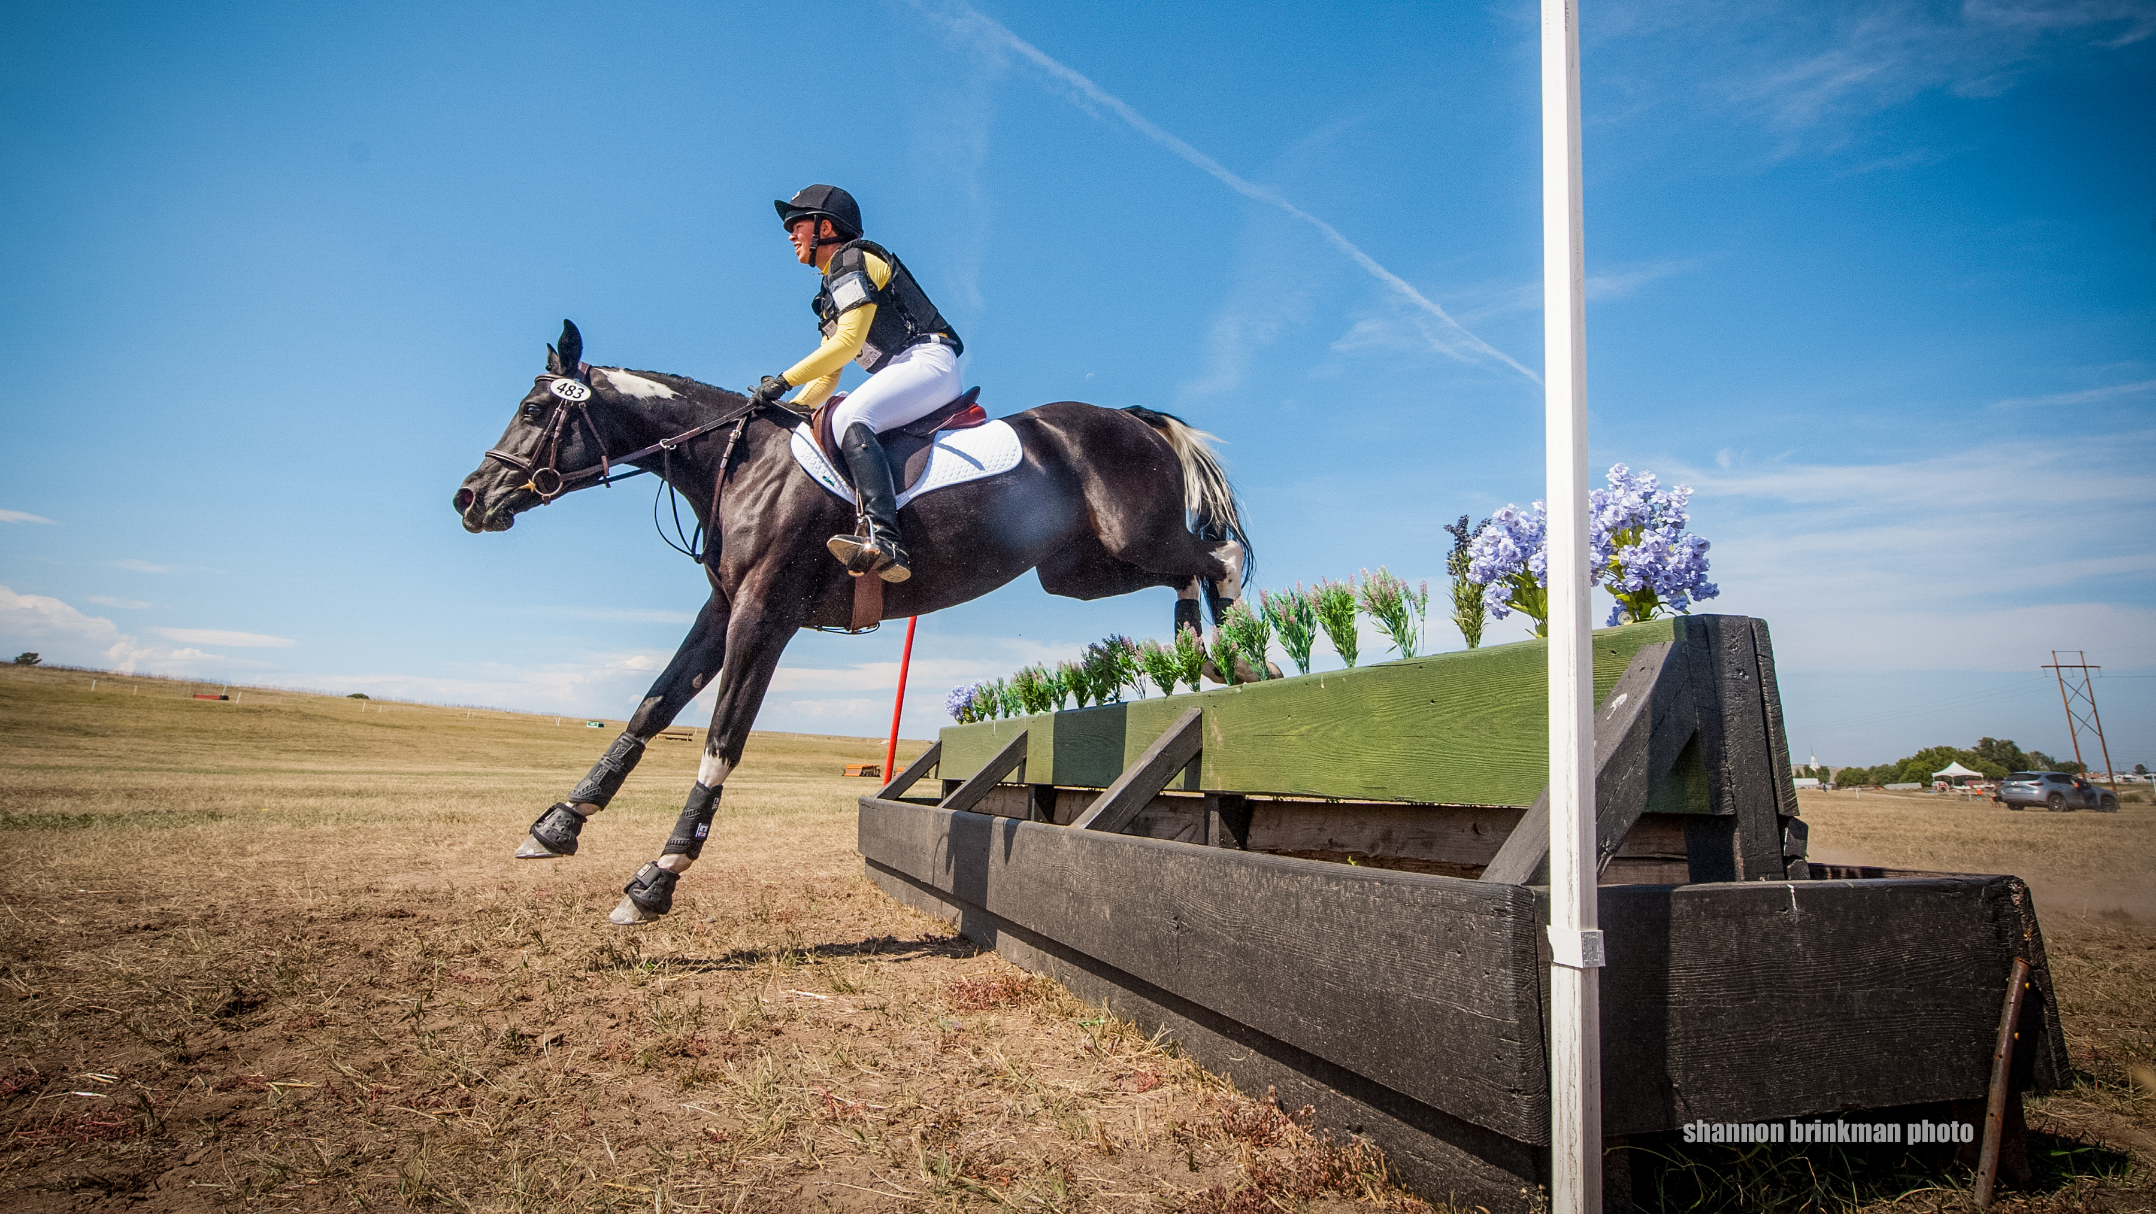
Predicting 3 Day Eventing Scores
Jacquie Schoeggl
Regis University
MSDS 692

Slide 2



What is 3 Day Eventing?
Originates from cavalry tests
"Equestrian Triathlon"

Slide 3
Shows horse's training and submission
Each movement is given a score 0-10, and the total points are calculated into a percentage
That percentage is subtracted from 100 to obtain a penalty score
Example: Jane and her horse score 98 out of 150 points.
98/150 = 0.653.
0.653 * 100 = 65.3
100 – 65.3 = 34.7 penalty points

Slide 4
Shows horse's bravery and stamina over a course of varied terrain and obstacles
Refusals or disobediences are penalized with 20 penalty points
If a horse and rider go over the optimum time, penalties are also added
Example: Jane and her horse scored 34.7 in dressage and had 1 refusal on cross country. They add 20 penalty points to their score for a total of 54.7

Slide 5
Shows horse's stamina and recovery after a hard day of cross country
Refusals or disobediences are penalized with 4 penalty points
The fall of a rail also results in 4 penalty points
If a horse and rider go over the optimum time, penalties are also added
Example: Jane and her horse have a total of 54.7 penalties. They knock down 2 rails, adding 8 penalty points to their score. Jane and her horse finish on 62.7 penalties

Slide 6
What are the different divisions?
Rider (R)
The horse cannot have completed an event above the next highest level
Amateur(A)
Competitors do not accept enumeration for riding or training horses
Junior (J)
Competitors under age 18
Youth (Y)
Master(M)
Competitors under age 14
Competitors over age 40
Horse (H)
Competitors who have not completed an event above the next highest level in the last five years

Slide 7
Project Plan/Overview
Is there a difference in scores between different divisions?
If so, which divisions are more competitive (I.e. lower scores)?
Are competitors from a certain division more likely to fall or be eliminated?
Is there a difference in scores from year to year?
Can the final score of a competitor be estimated given an initial dressage score and a division?

Slide 8
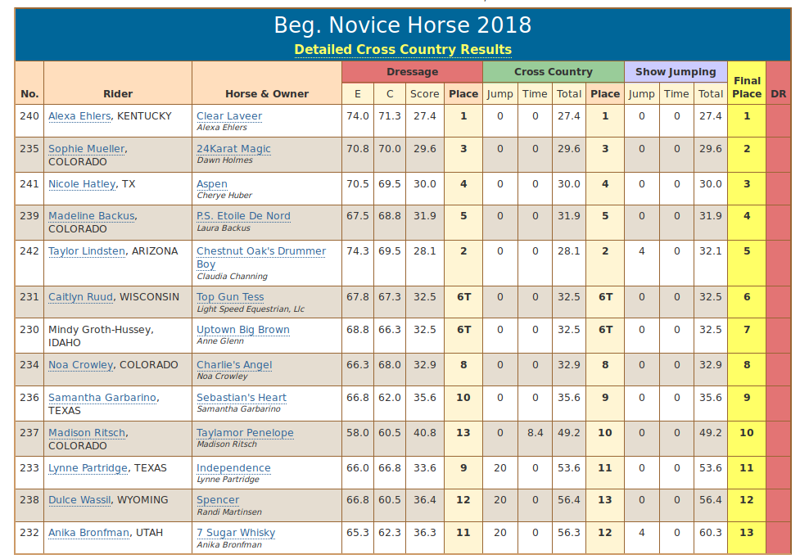
The Data
Data were collected from http://livescore.useventing.com/
collected data from 6 divisions over 3 years (2016-2018)
Rider, Horse and Owner names were removed as well as specific dressage scores
Year and Division were added as columns

Slide 9
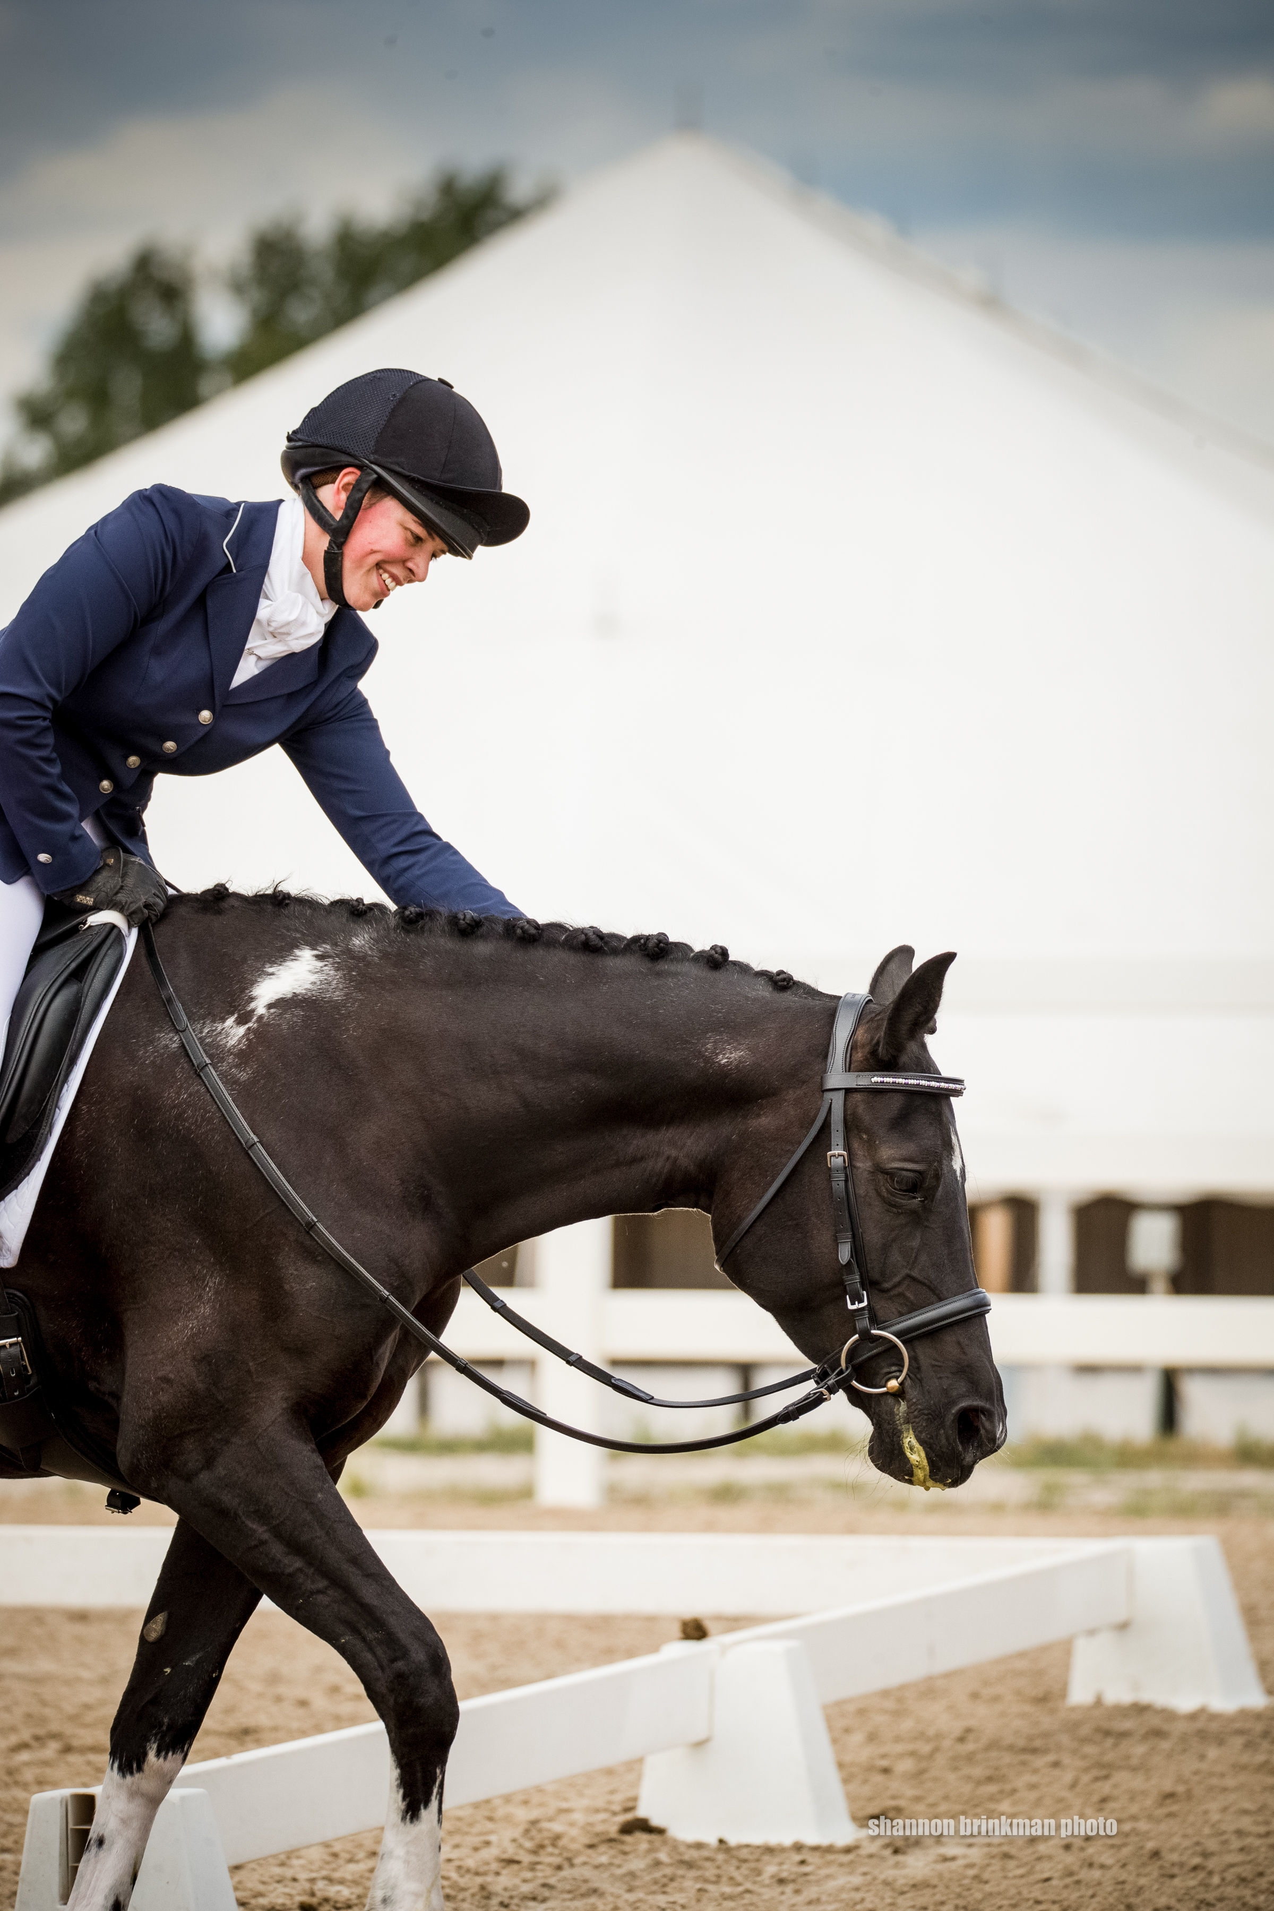
Exploratory Data Analysis
422
Total number of competitors who completed the event
43
Percentage of competitors who finished on their dressage score
19.8
Lowest score
271
Number of competitors who moved up in placing

Slide 10
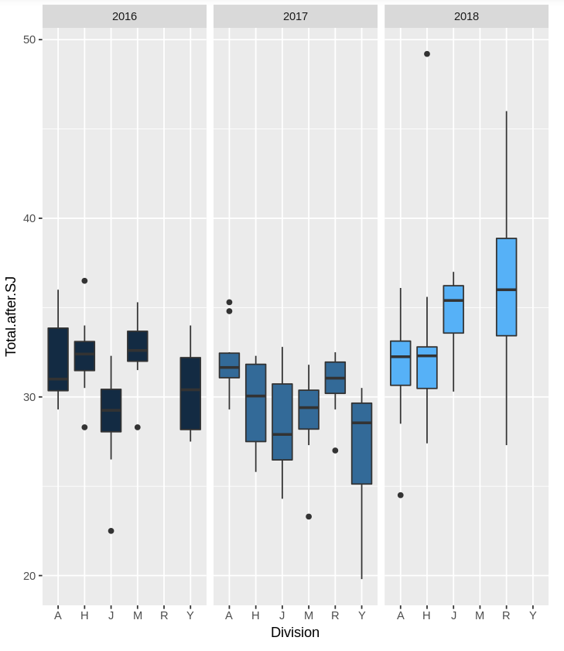
Exploratory Data Analysis Continued
Comparisions of scores from each year

Slide 11
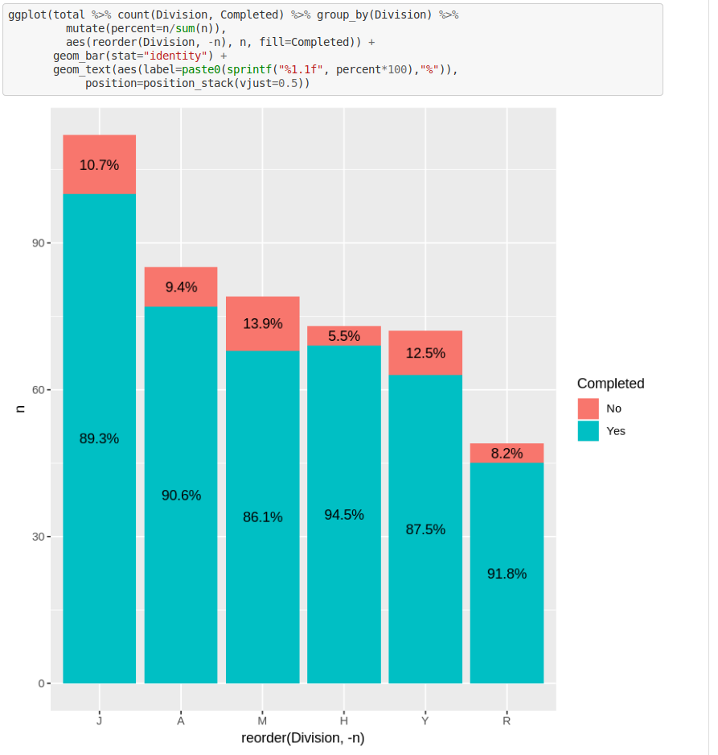
Feature Engineering

Slide 12
Machine Learning
Supervised
Regression
Linear Model

Slide 13
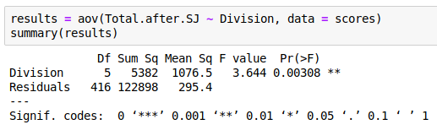
Linear Regression

Slide 14
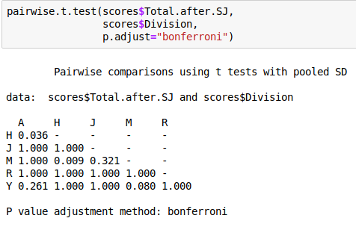
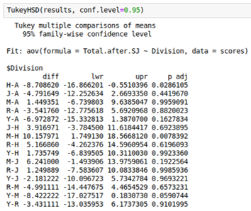
Post hoc Testing

Slide 15
there is a statistically significant difference between 3 divisions:
Youth and Master
Master and Junior
Amateur and Horse
Given the option between entering a Horse or Amateur division, the competitor should pick the _ Division because the scores are, on average, higher
This gives the competitor a better chance of placing well

Slide 16
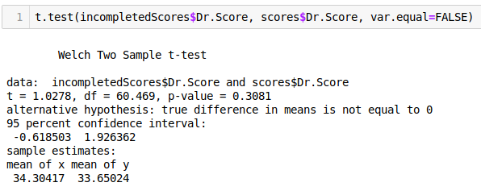
Is there a difference in dressage score from those that did not complete to those that did?

Slide 17
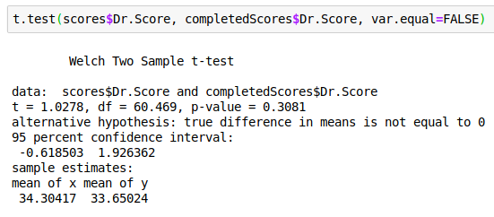
Is there a difference in Dressage Scores between those who complete and those who don't?

Slide 18
Examples of using Machine Learning!

Slide 19
Future Enhancements
Compare data from AECs to data from "normal" competitions
Compare scores from different heights to see if there is a common trend
Use data different events to predict the score of a specific competitor (requires lots of data collection)

Slide 20
Thank you

